Slide 1
MAT 3749
Introduction to Analysis
Section 2.3 Part III
The Mean Value Theorem
http://myhome.spu.edu/lauw

Slide 2


Important Result
$$a$$
$$b$$

Slide 3
Preview
Extreme Value Theorem
Fermat’s Theorem
Rolle’s Theorem
The Mean Value Theorem

Slide 4
References
Section 2.3

Slide 5
Maximum Value

Slide 6
Local Maximum

Slide 7
T or F
An absolute max is a local max.

Slide 8

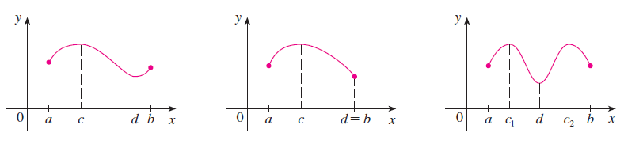
The Extreme Value Theorem

Slide 9
Fermat’s Theorem

Slide 10
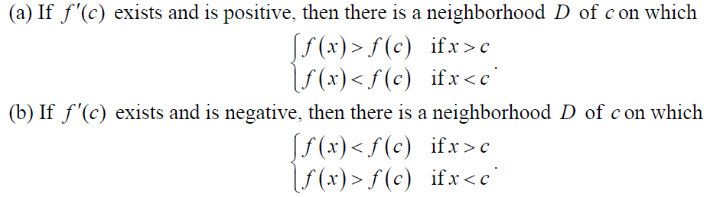
Lemma (HW)

Slide 11
Fermat’s Theorem

Slide 12
Conceptual Diagrams

Slide 13

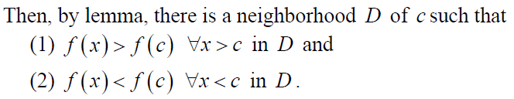
Fermat’s Theorem

Slide 14
Fermat’s Theorem

Slide 15
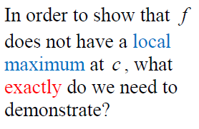
Fermat’s Theorem

Slide 16
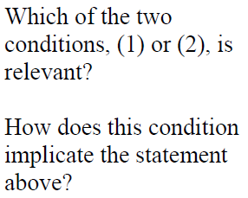
Fermat’s Theorem

Slide 17
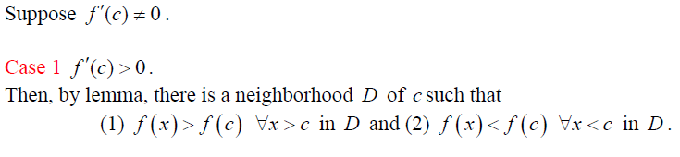
Proof

Slide 18
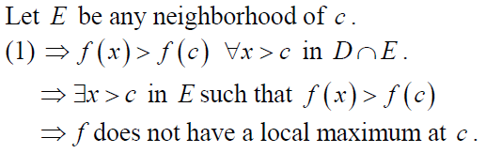
Proof

Slide 19
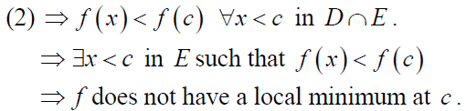
Proof

Slide 20
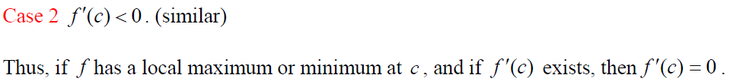
Proof

Slide 21
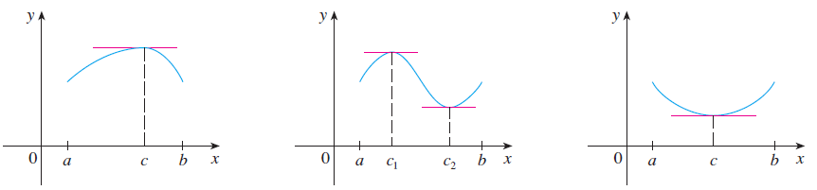
Rolle’s Theorem

Slide 22
Rolle’s Theorem

Slide 23

Rolle’s Theorem

Slide 24
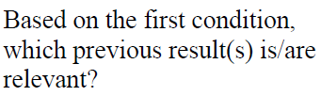
Rolle’s Theorem

Slide 25
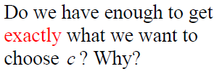
Rolle’s Theorem

Slide 26
Rolle’s Theorem

Slide 27
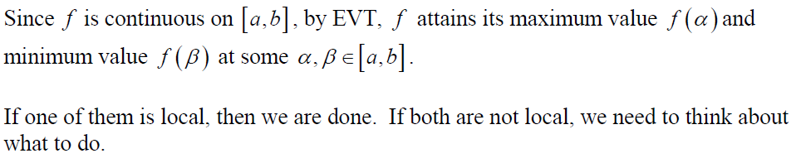
Rolle’s Theorem

Slide 28
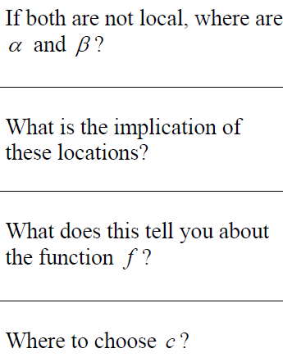
Rolle’s Theorem

Slide 29
Rolle’s Theorem

Slide 30
Rolle’s Theorem

Slide 31
Rolle’s Theorem

Slide 32
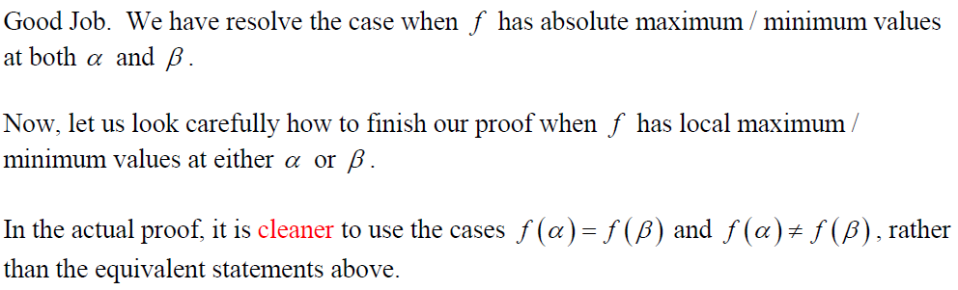
Rolle’s Theorem

Slide 33
Rolle’s Theorem

Slide 34
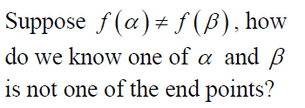
Rolle’s Theorem

Slide 35
Rolle’s Theorem

Slide 36
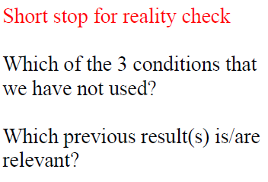
Rolle’s Theorem

Slide 37
Rolle’s Theorem

Slide 38

Rolle’s Theorem

Slide 39

Rolle’s Theorem

Slide 40
Rolle’s Theorem

Slide 41
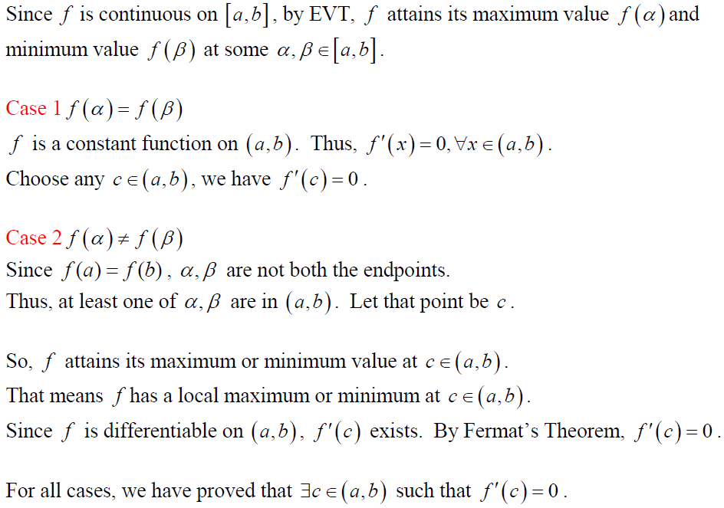
Proof

Slide 42
Proof

Slide 43
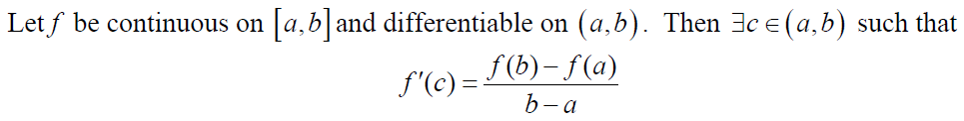
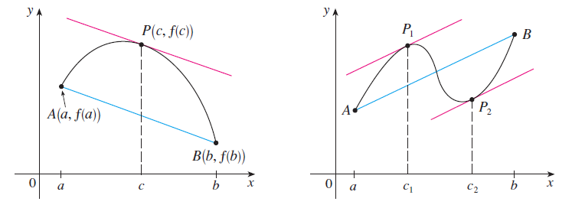
The Mean Value Theorem

Slide 44
The Mean Value Theorem

Slide 45
The Mean Value Theorem

Slide 46
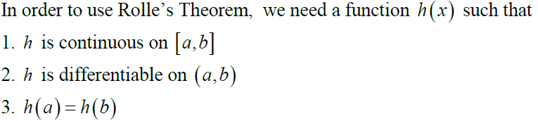
The Mean Value Theorem

Slide 47
The Mean Value Theorem

Slide 48
The Mean Value Theorem

Slide 49
The Mean Value Theorem

Slide 50
The Mean Value Theorem

Slide 51
The Mean Value Theorem

Slide 52
The Mean Value Theorem

Slide 53
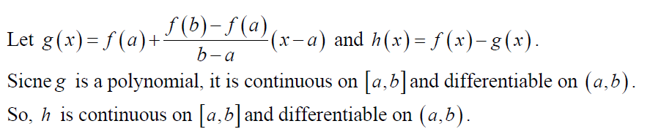
Proof

Slide 54
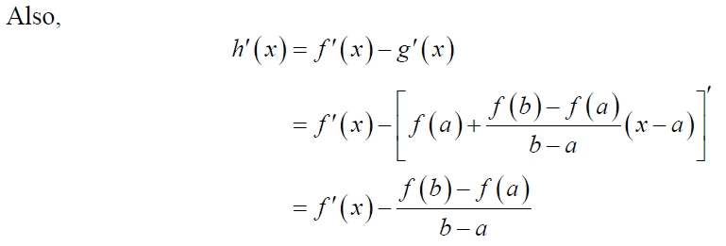
The Mean Value Theorem

Slide 55
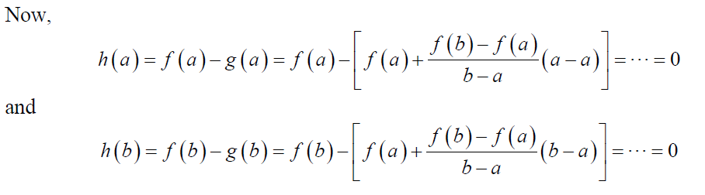
The Mean Value Theorem

Slide 56
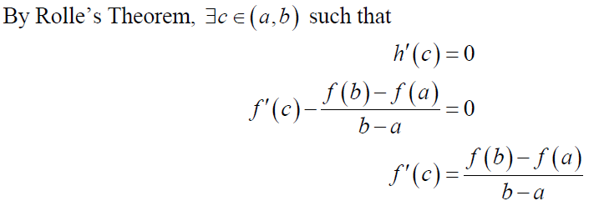
The Mean Value Theorem

Slide 57

Theorem (Consequence of the MVT)
If $f’(x)=0$for all $x$ in an interval $(a,b)$, then $f$ is constant on $(a,b)$.

Slide 58
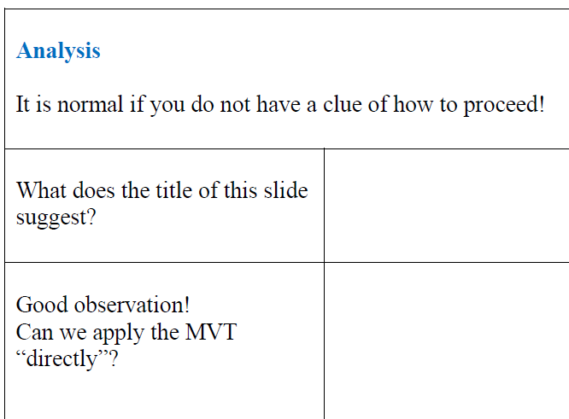
Theorem (Consequence of the MVT)

Slide 59
Theorem (Consequence of the MVT)

Slide 60
Theorem (Consequence of the MVT)

Slide 61
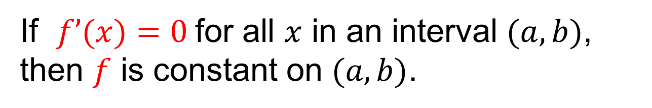
Theorem (Consequence of the MVT)
If $f’(x)=0$for all $x$ in an interval $(a,b)$, then $f$ is constant on $(a,b)$.

Slide 62
Theorem (Consequence of the MVT)
If $f’(x)=0$for all $x$ in an interval $(a,b)$, then $f$ is constant on $(a,b)$.

Slide 63
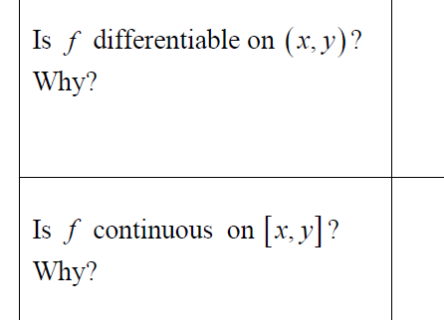
Theorem (Consequence of the MVT)
If $f’(x)=0$for all $x$ in an interval $(a,b)$, then $f$ is constant on $(a,b)$.

Slide 64
Theorem (Consequence of the MVT)
If $f’(x)=0$for all $x$ in an interval $(a,b)$, then $f$ is constant on $(a,b)$.

Slide 65
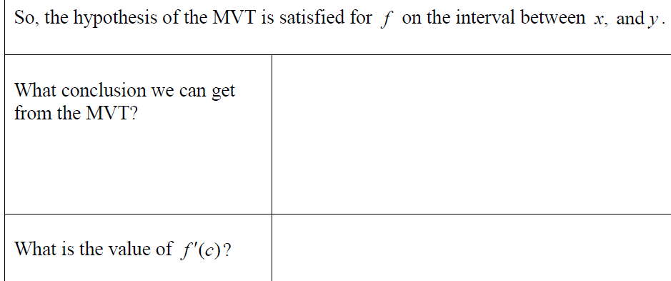
Theorem (Consequence of the MVT)

Slide 66
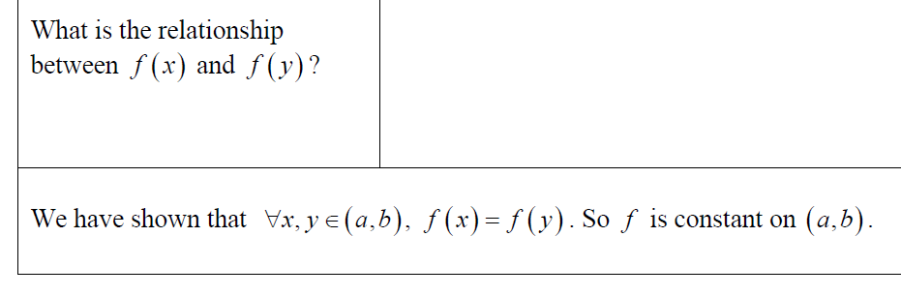
Theorem (Consequence of the MVT)

Slide 67
Theorem (Consequence of the MVT)

Slide 68
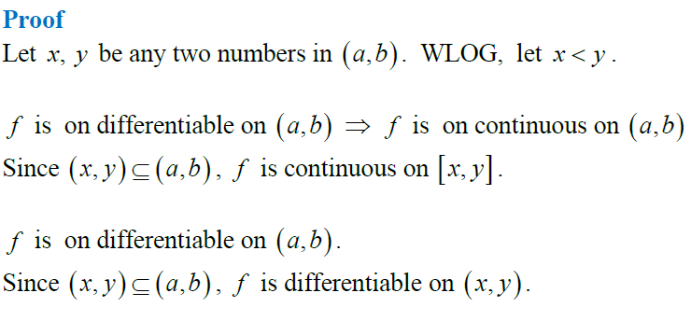
Theorem (Consequence of the MVT)

Slide 69
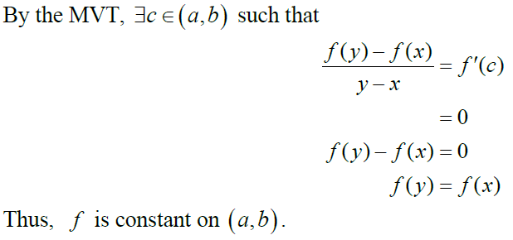
Theorem (Consequence of the MVT)

Slide 70
Corollary (Important)
$$a$$
$$b$$

Slide 71
Corollary (Important)
Why?
$$a$$
$$b$$

